Slide 1
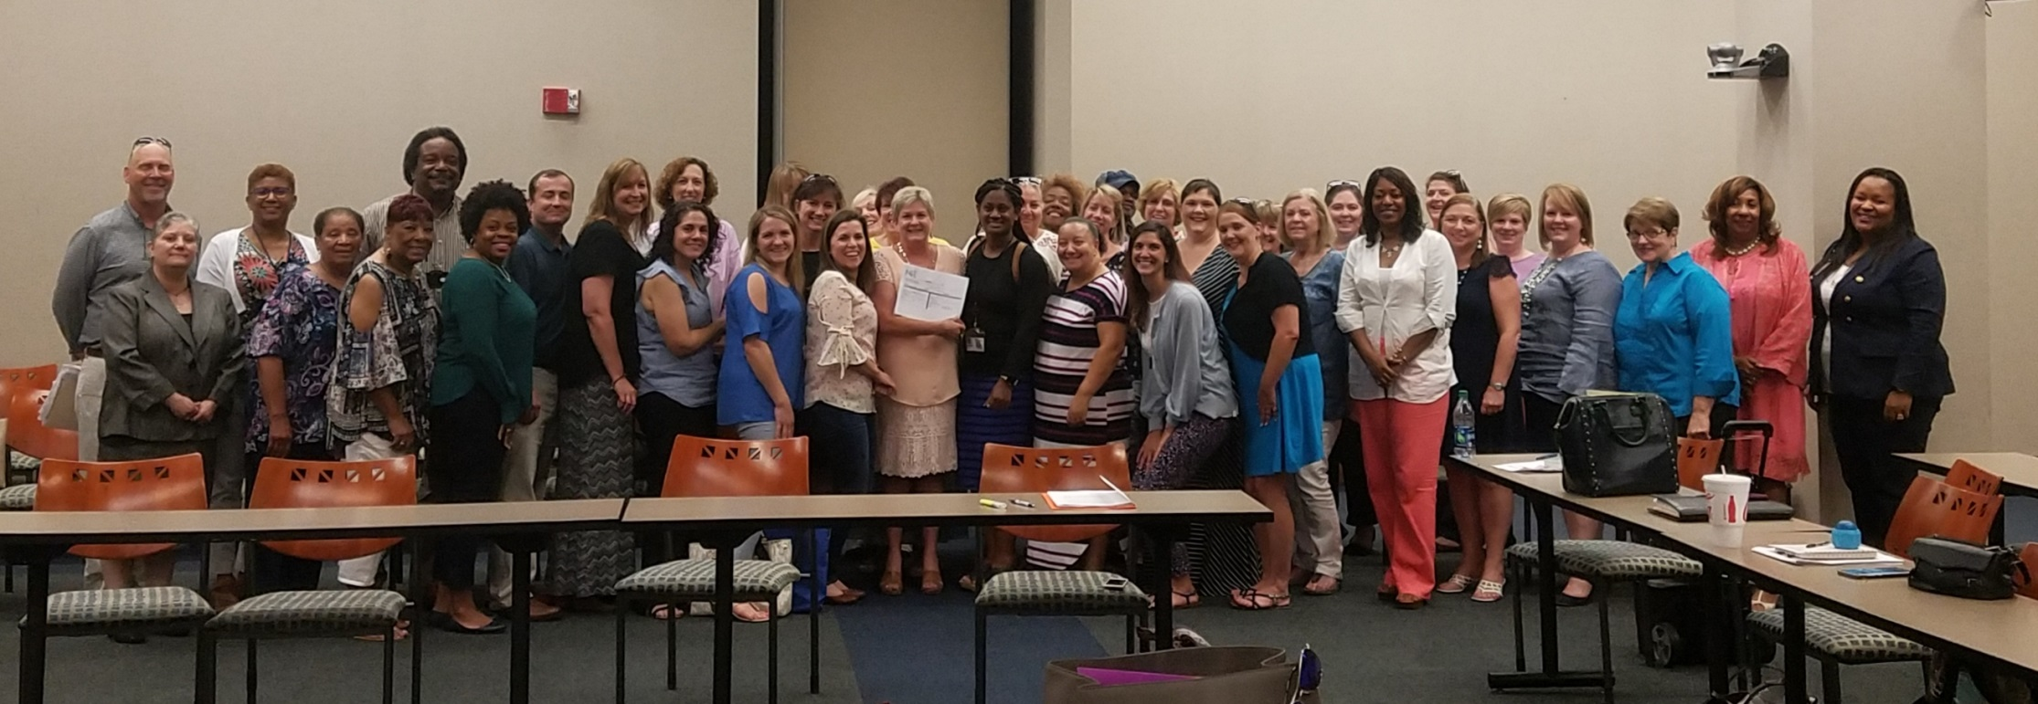
State Interagency Coordinating Council
(SICC)
Member Orientation 2019
Online Version

Slide 2

Welcome and Introductions

Slide 3
Meeting Objective
To provide orientation to members of the State Interagency Coordinating Council by:
Providing an overview of IDEA and EarlySteps
Reviewing all components that make up the SICC
So that all members are adequately informed about the goals of the SICC and the duties, roles, and responsibilities of membership.

Slide 4
Historical Overview of IDEA
EarlySteps, Louisiana’s Early Intervention System, is the Part C program of the Individuals with Disabilities Education Improvement Act (IDEA), which is federal legislation that was last reauthorized by US Congress in November 2004
https://www.youtube.com/watch?v=mHkLUp52vZ0

Slide 5
EarlySteps History and Legislation
Early intervention is a series of supports provided by authority of this federal law originally passed by Congress in 1986--32 years ago.
Louisiana has always participated in Early Intervention since the legislation began in 1986 and
was originally called ChildNet with the Louisiana Department of Education.
In July 2003, LDH became the Lead Agency, and the system name was changed to EarlySteps. OCDD administers the program in LDH.
Currently, every state participates in the IDEA Part C program (Ex. Georgia’s early intervention is called “Babies Can’t Wait.” Mississippi’s is “First Steps.” )
Before 1975—other federal and state funds provided services to agencies in Louisiana

Slide 6
IDEA Part C in Louisiana
Louisiana Law: Act 417, 2013 Session:
RS 28: 461-470
Rules: LAC Title 48:IX.334
Policies and Practice Manual: EarlySteps website

Slide 7
Purpose of IDEA Part C
Children and families enrolled in EarlySteps receive supports and services which enable them to help their child progress developmentally and to improve their child’s functioning as a family member within the daily routines of the family.
EarlySteps is a family education and training program.
System designed to meet the 5 purposes of
IDEA described in the video

Slide 8
Requirements of IDEA-C
Lead Agency designated by the Governor
Policy for arranging services, reimbursement, coordinate resources
Rights, Procedural Safeguards, Dispute Resolution
Data Collection and Reporting
Services in Natural Environments
Definition of developmental delay/eligibility and timely, family-directed evaluation
Child Find
Directory of services
Personnel Development

Slide 9
Supports and Services
Designed to meet:
Developmental needs of the Child
and assist the Family in their child’s development
Assistive Technology
Audiology
Family training, counseling
Health, Medical, Nursing Services
Nutrition
Special Instruction
Speech Language Pathology
Transportation
Translation/Interpreter
Vision
Occupational Therapy
Physical Therapy
Psychology
Service Coordination (FSC)
Social Work Services

Slide 10
Broad Overview of the SICC
SICC Membership
Membership Composition
Meeting Procedures/Structure
Roles and Functions
Use of Council Funds

Slide 11
SICC Mission
To design and oversee the implementation of a family-centered, community-based, comprehensive, interagency service delivery system for infants and toddlers (birth to two) who are eligible for Part C services, and their families.
This system will be monitored and evaluated to ensure that families are supported and that the potential of each child is maximized.

Slide 12
SICC Membership
The Council shall be appointed by the Governor.
The Governor shall ensure that the membership of the Council reasonably represents the population of the state.
The Governor shall designate a member of the Council to serve as chairperson of the Council.
Any member of the Council, who is representative of the Lead Agency, may not serve as the chairperson of the Council.

Slide 13
SICC Member Roles and Responsibilities
Represent your stakeholder group – bring and share information
Be aware of potential collaborative opportunities
Attend and participate in meetings – this is critical! Inform the Council chairperson or SICC staff if you will be unable to attend
Participate in committee or task groups established by the Council
Considering signing a yearly conflict of interest statement
[Review document 1.9 & 1.10]

Slide 14
SICC Membership
Composition
In general.--The council shall be composed as follows:
Parents.--Not less than 20 percent of the members
Service providers.--Not less than 20 percent of the members
State legislature.--Not less than 1 member
Personnel preparation.--Not less than 1 member
Agency responsible for payment/service provision of early intervention services.--Not less than 1 member
Agency for preschool services for children with disabilities--Not less than 1
State Medicaid agency.--Not less than 1 member
Head start agency.--Not less than 1 member
Child care agency.--Not less than 1 member
Agency for private health insurance.--Not less than 1 member
Office of the coordinator of education of homeless children and
youth.--Not less than 1 member
State foster care representative.--Not less than 1 member
Mental health agency.--Not less than 1 member
Other members.--The council may include other members

Slide 15

Structure is important

Slide 16
Creating Structure Can Be Useful
Standard Operating Procedures
Bylaws
Robert’s Rules of Order
Understanding Louisiana’s Open Meetings Laws

Slide 17
SICC
Meeting Procedures
These general meeting procedures should be implemented by all ICCs:
The council shall meet at least quarterly and in such places as it deems necessary. The meetings must –
Be publicly announced sufficiently in advance of the dates they are to be held to ensure that all interested parties have an opportunity to attend
Be open and accessible to the public
Interpreters for persons who are deaf or hard of hearing and other necessary services must be provided at council meetings, both for council members and participants. The council may use funds under this part to pay for these services.

Slide 18
Procedures cont.
Official minutes must be kept of all council meetings and must be made available on request.
By July 1 of each year, the Interagency Coordinating council shall submit an annual report on the status of the early intervention program.

Slide 19
Ground Rules for Meetings
Members must wait to be recognized before speaking
Visitors must be recognized before speaking.
Visitors are welcome to provide comments or ask questions throughout the meeting after the committee members have had a chance to do so on each issue.
Visitors comments and questions are limited to the items on the committee’s agenda and shall be limited to 3 minutes
Extra time can be given at the discretion of the chair

Slide 20
Ground Rules cont.
Caution individuals giving public comment to be factual and objective. Avoid using names of children or program/agency staff. Maintain confidentiality and privacy standards.
Do not interrupt the speaker during his/her 3 minutes. Ask clarifying questions after the speaker is finished.
Provide a verbal or visual cue 1 minute before the speaker’s time is up.

Slide 21
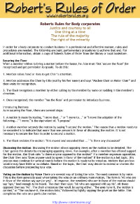
Robert’s Rules of Order

Slide 22
Basic Rules of Order
Each member has equal rights and responsibilities. You and your ideas are as important as anyone else’s.
The group should always decide what is best for the entire council.

Slide 23
AGENDA TOPICS
Call the meeting to order
Introductions
Adoption of the agenda
Determine quorum (simple majority)
Reading/Reviewing of the previous minutes
Reports
  Motions are rarely made to receive reports

Slide 24
Members in
Parliamentary Procedures
Privileges
You have the right to present any motion that has a bearing on business matters concerning the Council/Committee and to expect the right to explain or discuss the motion without interruption.
To question procedures if they are being violated.
To participate in the discussion of all motions.

Slide 25
Responsibilities
Participate fully in all Council/Committee meetings and activities.
Obtain the floor (get the Chairperson to recognize you) before speaking.
Stick to the topic being discussed until it is resolved.
Respond to the Chairperson when a call to order is made.
When debating an issue, stick to the issue.
Be punctual to all meetings.
Remain for the entire meeting.

Slide 26
What is a Motion?
A recommendation made by a member of the Council for the entire Council to consider and possibly take action.
Step in the Process of a Motion
Recognition
Make the motion
It must be seconded
Clearly state the motion
Discussion
State the motion again
Ask if there are any objections to the motion
Ask for any abstentions

Slide 27
If there are no objections, say, “Hearing no objection, the motion carries.”
  If someone objects to the motion, take a vote.
  Call the role (for yes or no vote, or abstention)
Motion either carries or does not carry.

Slide 28
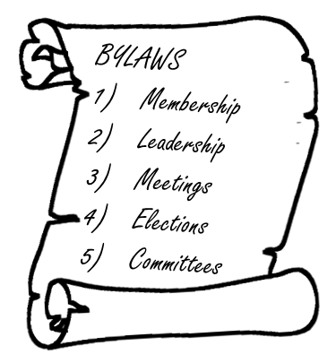
Bylaw Review

Slide 29
Louisiana
Open Meetings Laws
https://app.lla.state.la.us/llala.nsf/BAADB2991272084786257AB8006EE827/$FILE/Open%20Meetings%20Law%20FAQ.pdf

Slide 30
SICC Roles

Slide 31
SICC Roles
Advise and Assist the Lead Agency with certain functions:
Advise and assist the Lead Agency in the development, approval, and implementation of policies.
Assist in achieving full participation, coordination, and cooperation of all appropriate and private and public agencies.
Assist in the effective implementation of the statewide system, by establishing a process that includes:
Seeking information about any federal, state, or local policies that impede timely service delivery
Taking steps to ensure that any policy problems identified are resolved
To the extent appropriate, assisting the lead agency in the resolution of disputes.

Slide 32
SICC Roles cont.
Advise and Assist the Lead Agency in:
Identification of fiscal and other support
Assignment of financial responsibility
Promotion of methods for collaboration
Preparation of applications
The transition of toddlers to preschool and other services
[Document 1.5 is provided as a reference]

Slide 33
Council Use of Funds
Subject to the approval of the Governor, the council may prepare and approve a budget using funds under this part to:
conduct hearings and forums
to reimburse members of the council for reasonable and necessary expenses for attending council meetings and performing council duties (including child care for parent representatives)
to pay compensation to a member of the council if the member is not employed or must forfeit wages from other employment when performing official council business
to hire staff, and to obtain the services of such professional, technical, and clerical personnel as may be necessary to carry out its functions under this part

Slide 34
Roles of
Lead Agency Administrator
Support the SICC in carrying out their functions and responsibilities
Represents the lead agency as a non-voting member
Assists with developing the agenda
Reports on topical issues and priorities
Provides a State-of-the-State/Lead Agency Report at SICC meetings
Reports on and seeks input for State Performance Plan and Annual Performance Report

Slide 35
LA Admin role cont…
Reports on the annual Level of Determination for State and local programs
Reviews and comments on the SICC annual report
Updates the SICC on State, Regional, and Federal issues
Assists in identifying SICC priorities and goals
Provides administrative support and/or funds for the SICC

Slide 36
Committee Composition
Committee membership (excluding Executive Committee) shall consist of
Representatives from the following stakeholder groups:
SICC Members
OCDD Staff
Family/Parent
State Agency Representative
Regional Coordinator
Community Outreach Specialist
Independent Provider
Agency Provider
Family Service Coordinator
System Point of Entry
Local Education Agency
University/Higher Education Institution
Early Head Start/Head Start
Early Childhood/Regular Education
Other members as determined by Chair/VC

Slide 37
Executive Committee
Council Officers (SICC Chairperson, SICC Vice-Chairperson, Secretary, Parliamentarian, & Parent-at-large)
SICC Chairperson chairs the Executive Committee
SICC Committee Chairpersons
Lead Agency Representative
SICC Executive Director assists with operations

Slide 38
Executive Committee
The Executive Committee provides leadership for the SICC and Lead Agency:
oversees the activities of the Executive Director
appoints the other committee members
appoints task forces as needed
plans SICC quarterly meeting agendas
handles special requests/concerns as related to EarlySteps
certifies the Annual Performance Report
Oversees the business of the SICC: agendas, etc.

Slide 39
Family Assessment
Committees were re-formed in 2017
Family Assessment to establish the process that identifies and supports family concerns, priorities, and resources needed to address their child’s development resulting in functional IFSP outcomes
Approximately 17 members co-chaired by Monica Stampley and Mary Hockless

Slide 40
Team-Based Practice Supports
Developing and implementing a Team-based approach where early interventionists and families collaborate with each other to address the family CPRs
Approximately 12 members, chaired by Tim Butler

Slide 41
Service Delivery Supports Family Priorities
Service Delivery supports Family Priorities such that early interventionists address IFSP outcomes using intervention strategies where both the child and family are actively engaged and focused on familiar, everyday routines and activities.
Approximately 12 members chaired by Shanida Mathieu and Marc Garnier

Slide 42
How to join a committee
Request an application from the Executive Director or committee chairs
Your application will be reviewed at the next Executive Committee meeting for approval and you will be notified of your acceptance.
Co-chairs are elected by committee members
If you have questions about which committee may be the best fit, reach out to the Executive Director or attend the subcommittee meetings held the mornings of the SICC quarterly meeting

Slide 43
Characteristics of
Effective ICC’s
Dual Focus – policies and services
Problem-solving or action group
Includes:
  Family members
  Primary service Providers
  Management representatives
  Consistent attendance/representation
  Equal partnership among all members
  Consistent leadership
  Well-defined goals
  Group Cohesiveness
  Established meeting procedures and times
  Set Agenda

Slide 44
Questions?
Discussion.
Wrap-Up!
In Conclusion……..

